Slide 1


AJMAL SHAFI
Sunday, July 9, 2023

Slide 2

Outline
Executive Summary
Introduction
Methodology
Results
Conclusion
Appendix

Slide 3
Executive Summary
Summary of methodologies
The research attempts to identify the factors for a successful rocket landing. To make this determination, the following methodologies were used:
• Data Collection from SpaceX REST API and web scraping
• Data Wrangling for creating success/fail outcome variable
• Exploratory data analysis (EDA) using SQL, Pandas and Matplotlib
• Interactive Visual Analytics and Dashboard with Follium and Plotly Dash
• Build Classification Models for Predictive Analysis
Summary of all results
Exploratory Data Analysis:
• Launch success has improved over time
• KSC LC-39A has the highest success rate among landing sites
• Orbits ES -L1, GEO, HEO, and SSO have a 100% success rate
Visualization Analytics:
• Most launch sites are near the equator, and all are close to the coast
Predictive Analytics:
• All models performed similarly on the test set.

Slide 4
Introduction
Project background and context
Space Y is here to compete in the commercial space race. We are making rocket launches relatively inexpensive for everyone.
Problems you want to find answers
• How payload mass, launch site, number of flights, and orbits affect first-stage landing success
• Rate of successful landings over time
• Best predictive model for successful landing

Slide 5

Section 1

Slide 6
Methodology
Executive Summary
Data collection methodology:
The data was collected from the SpaceX Rest API and web scraping from Wikipedia Pages
Perform data wrangling
The data was collected in the form a .JSON object and HTML tables and then is converted into pandas dataframe for analysis and visualization by filtering the data, handling missing values and applying one hot encoding
Perform exploratory data analysis (EDA) using visualization and SQL Techniques
Perform interactive visual analytics using Folium and Plotly Dash
Perform predictive analysis using classification models
Use of machine learning to build model to predict landing outcomes using classification model, tune and evaluate models to find best model and parameters

Slide 7
Data Collection
The data was collected from the SpaceX Rest API and web scraping from Wikipedia Pages
SpaceX Rest API End Point
Get Request using the requests library
Get past launch data as JSON objects
Convert the JSON to a dataframe
Web scraping Falcon 9 launch records
Beautifulsoup to web scrape HTML Table
Parse data from Tables
Convert tables into a dataframe

Slide 8
Data Collection – SpaceX API
Collect and make sure the data is in the correct format from an API as per below steps:
• Request data from SpaceX API (rocket launch data)
• Decode response using .json() and convert to a dataframe using .json_normalize()
• Request information about the launches from SpaceX API using custom functions
• Create dictionary from the data
• Create dataframe from the dictionary
• Filter dataframe to contain only Falcon 9 launches
• Replace missing values of Payload Mass with calculated .mean()
• Export data to csv file
Data Collection Notebook
Request Data
Decode Resp. JSON
Request Information
Create Dataframe
Create dictionary
Filter Dataframe
Replace Missing Value
Export Data to CSV

Slide 9
Data Collection - Scraping
Perform web scraping to collect Falcon 9 historical launch records from Wikipedia page as per below steps:
• Request data (Falcon 9 launch data) from Wikipedia
• Create BeautifulSoup object from HTML response
• Extract column names from HTML table header
• Collect data from parsing HTML tables
• Create dictionary from the data
• Create dataframe from the dictionary
• Export data to csv file
Web Scraping Notebook
Request Data
Create beautiful soup object
Extract column name
Create Dictionary
Collect Data Parse HTML Table
Filter Dataframe
Export Data to CSV

Slide 10
Data Wrangling
Perform Exploratory Data Analysis (EDA) to find patterns in the data and determine what would be the label for train supervised models
The variable represents the classification outcome of each launch. Zero means, the first stage land unsuccessfully, One means the first stage land successfully
Data Wrangling Notebook
Identify the missing value
Identify which columns are numerical and categorial
Calculate the # of launches on each site
Create a landing outcome label form outcome column
Calculate the # and occurrence of mission outcome per orbit type
Calculate the # and Occurrence of each orbit

Slide 11
EDA with Data Visualization
Catplot Charts were plotted to visualize relationship between:
• Flight Number vs. Payload
• Flight Number vs. Launch Site
• Payload Mass (kg) vs. Launch Site
• Payload Mass (kg) vs. Orbit type
Visualization Analysis
• Scatter plots view relationship between the variables that could be useful for machine learning if a relationship exists
• Bar Charts show comparisons among discrete categories and show the relationships among the categories and a measured value.
EDA with Visualization

Slide 12
EDA with SQL
Queries display:
• Names of unique launch sites
• 5 records where launch site begins with ‘CCA’
• Total payload mass carried by boosters launched by NASA (CRS)
• Average payload mass carried by booster version F9 v1.1. List:
• Date of first successful landing on ground pad
• Names of boosters which had success landing on drone ship and have payload mass greater than 4,000 but less than 6,000
• Total number of successful and failed missions
• Names of booster versions which have carried the max payload
• Failed landing outcomes on drone ship, their booster version and launch site for the months in the year 2015
• Count of landing outcomes between 2010-06-04 and 2017-03-20 (desc)
EDA with SQL

Slide 13
Build an Interactive Map with Folium
Markers Indicating Launch Sites
• Added blue circle at NASA Johnson Space Center's coordinate with a popup label showing its name using its latitude and longitude coordinates
• Added red circles at all launch sites coordinates with a popup label showing its name using its name using its latitude and longitude coordinates Map with Folium
Colored Markers of Launch Outcomes
• Added colored markers of successful (green) and unsuccessful (red) launches at each launch site to show which launch sites have high success rates
Distances Between a Launch Site to Proximities
• Added colored lines to show distance between launch site CCAFS SLC40 and its proximity to the nearest coastline, railway, highway, and city
Map with Folium

Slide 14
Build a Dashboard with Plotly Dash
Dropdown List with Launch Sites
• Allow user to select all launch sites or a certain launch site
Slider of Payload Mass Range
• Allow user to select payload mass range
Pie Chart Showing Successful Launches
• Allow user to see successful and unsuccessful launches as a percent of the total
Scatter Chart Showing Payload Mass vs. Success Rate by Booster Version
• Allow user to see the correlation between Payload and Launch Success
Dashboard with Plotly Dash

Slide 15
Predictive Analysis (Classification)
Summary of the model development process used to predict if the 1st stage will land given the data form the preceding labs.
• Create NumPy array from the Class column
• Standardize the data with StandardScaler. Fit and transform the data.
• Split the data using train test split
• Create a GridSearchCV object with cv=10 for parameter optimization
• Apply GridSearchCV on different algorithms: logistic regression (LogisticRegression()), support vector machine (SVC()), decision tree (DecisionTreeClassifier()), K-Nearest Neighbor (KNeighborsClassifier())
• Calculate accuracy on the test data using .score() for all models
• Assess the confusion matrix for all models
• Identify the best model that perform best using test data
Machine Learning Prediction

Slide 16
Predictive Analysis (Classification)
Machine Learning Prediction
Load of the data dataset_part_2.csv and dataset_part_3.csv
Use of dataset_part_2.csv for creation of variable Y from the column class
Use of dataset_part_3.csv the features_one_hot dataframe for creation of Variable X
Selection of method that performs best
Best parameters, accuracy and confusion matrix
Creation of Logistic Regression, SVM, Decision Tree, KNN and GridsearchCV objects
Train test split to split the data into training and test data

Slide 17
Results
Exploratory data analysis results
Interactive analytics demo in screenshots
Predictive analysis results

Slide 18

Section 2

Slide 19
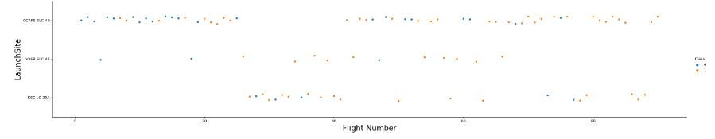
Flight Number vs. Launch Site
With time the successful rate has increased for every launch site, especially for CCAFS SLC40, where are concentrated the majority of the launches
VAFB SLC 4E and KSC LC 39A has a higher successful rate but represent one third of total launches

Slide 20
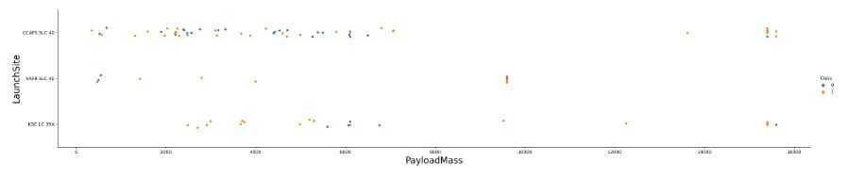
Payload vs. Launch Site
• Typically, the higher the payload mass (kg), the higher the success rate
• Most launces with a payload greater than 7,000 kg were successful
• KSC LC 39A has a 100% success rate for launches less than 5,500 kg
• VAFB SKC 4E has not launched anything greater than 10,000 kg

Slide 21
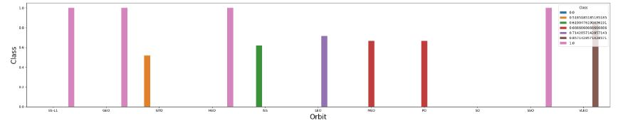
Success Rate vs. Orbit Type
• 100% Success Rate: ES-L1, GEO, HEO and SSO
• 50%-80% Success Rate: GTO, ISS, LEO, MEO, PO
• 0% Success Rate: SO

Slide 22
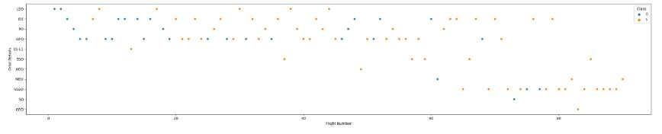
Flight Number vs. Orbit Type
• The success rate typically increases with the number of flights for each orbit
• This relationship is highly apparent for the LEO orbit
• The GTO orbit, however, does not follow this trend

Slide 23
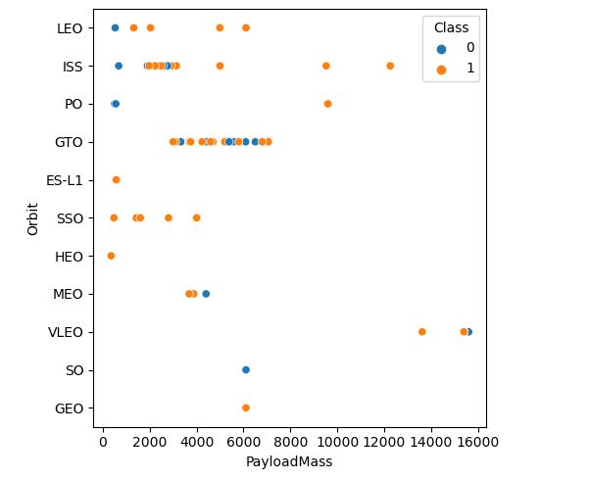
Payload vs. Orbit Type
• Heavy payloads are better with LEO, ISS and PO orbits
• The GTO orbit has mixed success with heavier payloads

Slide 24
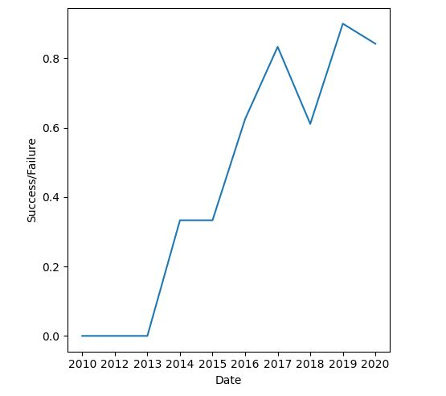
Launch Success Yearly Trend
• The success rate improved from 2013-2017 and 2018-2019
• The success rate decreased from 2017-2018 and from 2019-2020
• Overall, the success rate has improved since 2013

Slide 25
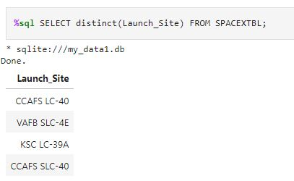
All Launch Site Names
Find the names of the unique launch sites
The four unique launch sites in the space
mission.
Used “Distinct” statement to find the
unique values in the launch site
column.

Slide 26
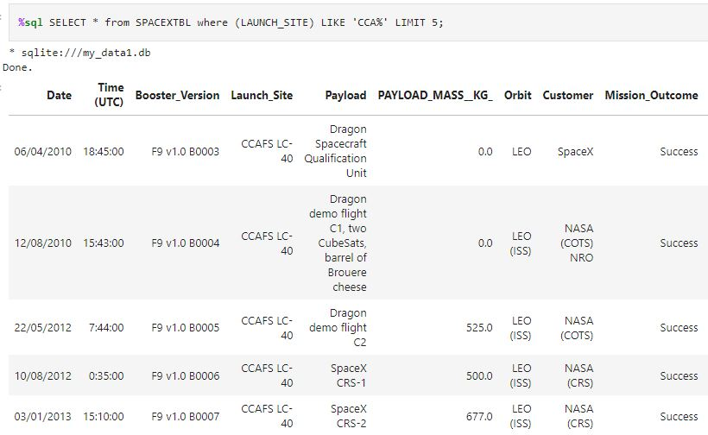
Launch Site Names Begin with 'CCA'
Five records where launch sites begin with the string ‘CAA’. The query uses WHERE, LIKE and LIMIT.

Slide 27
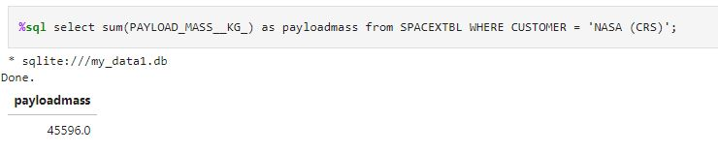
Total Payload Mass
The total payload carried by boosters from NASA (CRS) using the SUM function and WHERE clause.

Slide 28
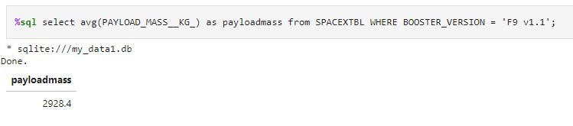
Average Payload Mass by F9 v1.1
The average payload mass carried by booster version F9 v1.1 using AVG() function and WHERE clause.

Slide 29
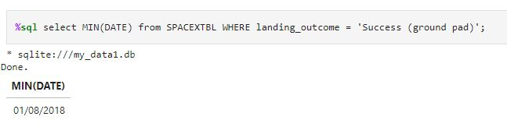
First Successful Ground Landing Date
The dates of the first successful landing outcome on ground pad was gathered by using MIN function and WHERE clause.

Slide 30
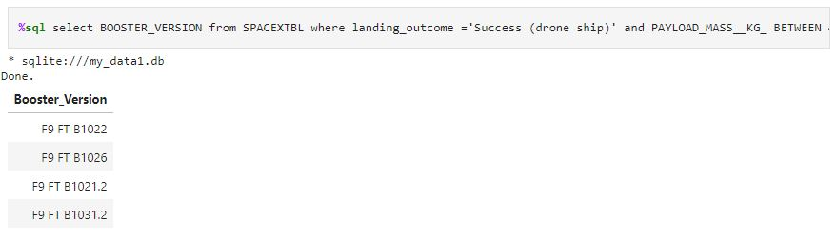
Successful Drone Ship Landing with Payload between 4000 and 6000
The names of boosters which have successfully landed on drone ship and had payload mass greater than 4000 but less than 6000, combining WHERE clause with AND operator.

Slide 31
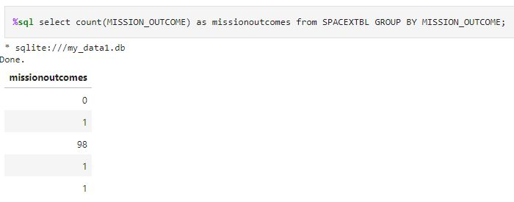
Total Number of Successful and Failure Mission Outcomes
The total number of successful and failure mission outcomes calculated by using the query of a combination of COUNT function with GROUP BY statement.

Slide 32
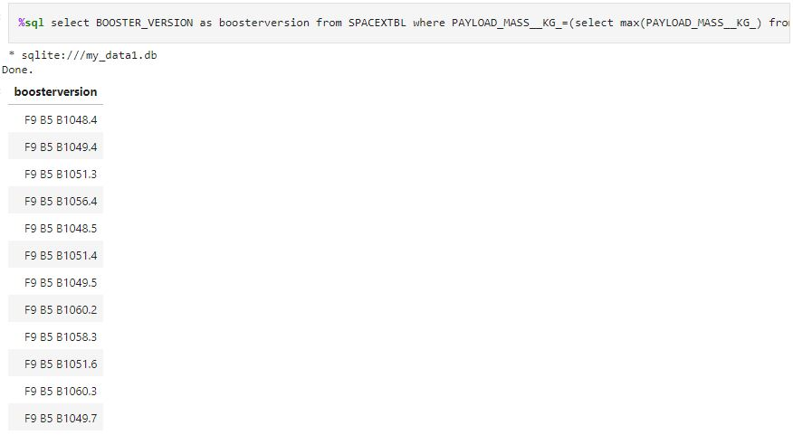
Boosters Carried Maximum Payload
The names of the booster which have carried the maximum payload mass was calculated by using subquery.

Slide 33
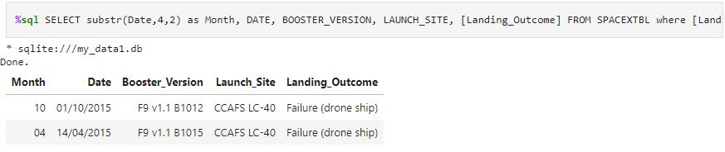
2015 Launch Records
The failed landing_outcomes in drone ship, their booster versions, and launch site names for in year 2015.

Slide 34
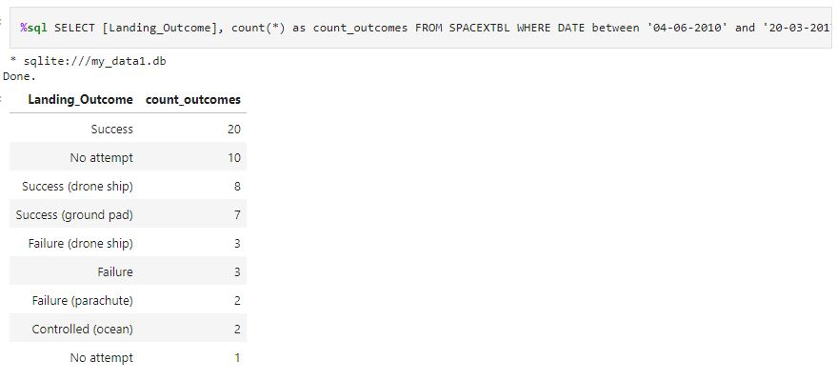
Rank Landing Outcomes Between 2010-06-04 and 2017-03-20
The count of landing outcomes (such as Failure (drone ship) or Success (ground pad)) between the date 2010-06-04 and 2017-03-20, in descending order was calculated by using the query COUNT, WHERE, BETWEEN and GROUP BY.

Slide 35

Section 3

Slide 36
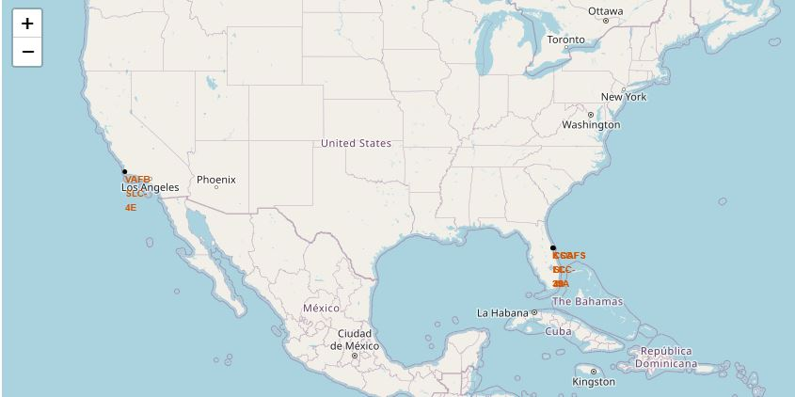
All Launch Sites
Near Equator: the closer the launch site to the equator, the easier it is to launch to equatorial orbit, and the more help you get from Earth's rotation for a prograde orbit. Rockets launched from sites near the equator get an additional natural boost - due to the rotational speed of earth - that helps save the cost of putting in extra fuel and boosters.

Slide 37
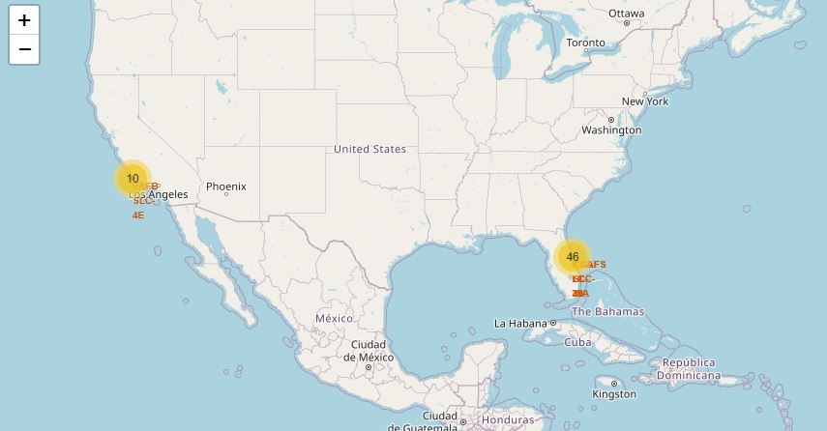
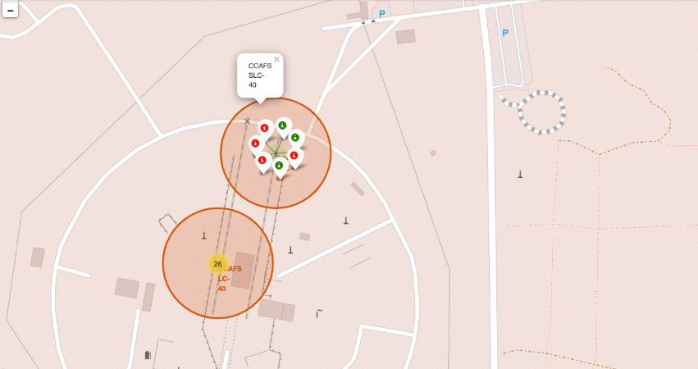
Each Site success/failed Launches
The first map shoes clusters of each launch site, the second shows green marker for successful launch and red marker for unsuccessful launch

Slide 38
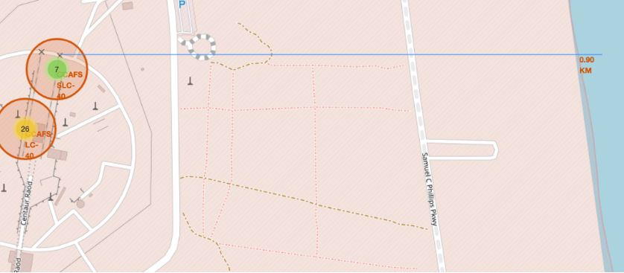
A Launch Site with Proximities
Launch sites are near to railways, roads, highways and coastline. You noticed, it is not easy for supply or access but, for maintain a safe distance with near cities.

Slide 39

Section 4

Slide 40
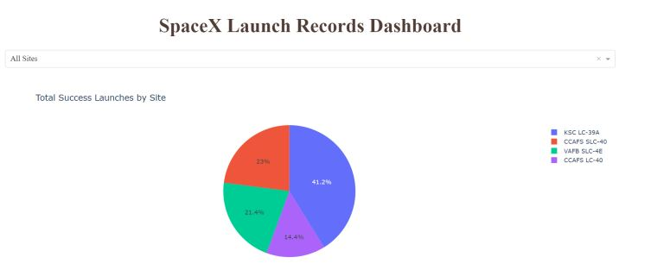
Total Success Launches By Site
KSC LC-39A is the site with the highest success launches followed by CCAFS LC-40

Slide 41
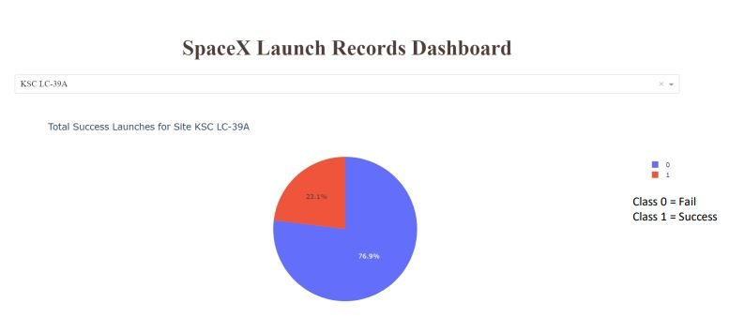
KSC LC-39A
Pie Chart for the launch site KSC LC-39A shows the site with highest launch success ratio.

Slide 42
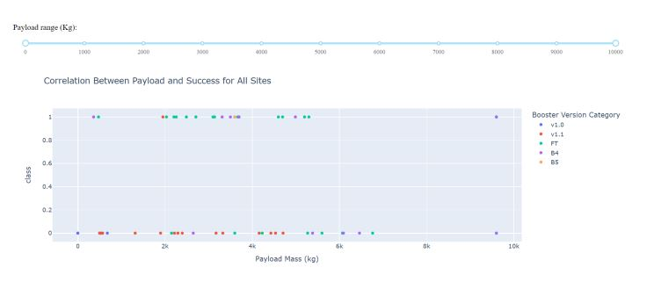
Payload vs. Launch Outcome
Scatter plot for all sites with 2500, 5000 and 10000(kg) payload ranges. The 2500-5000(kg) range concentrate the majority of the successfully launches, but 0-2500(kg) range has most failed launches but all three similar.

Slide 43

Section 5

Slide 44
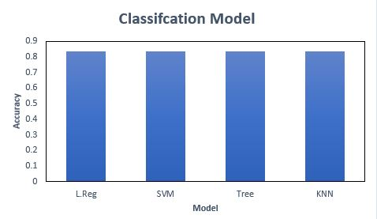
Classification Accuracy
The accuracy is the same for all models.

Slide 45
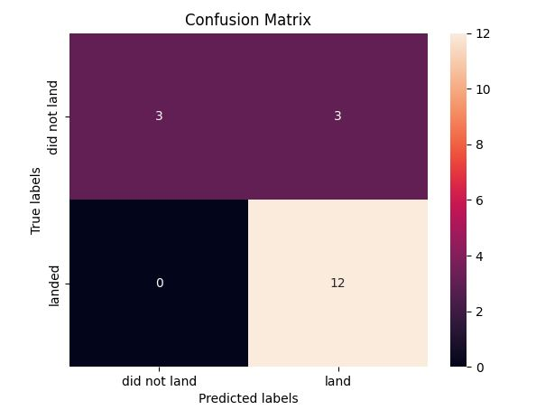
Confusion Matrix
All the confusion matrix were identical for all models.

Slide 46
Conclusions
• Model Performance: All the models performed similarly on the test set.
• Equator: Most of the launch sites are near the equator for an additional natural boost - due to the rotational speed of earth - which helps save the cost of putting in extra fuel and boosters
• Coast: All the launch sites are close to the coast
• Launch Success: Increases over time
• KSC LC-39A: Has the highest success rate among launch sites. Has a 100% success rate for launches less than 5,500 kg
• Orbits: ES-L1, GEO, HEO, and SSO have a 100% success rate
• Payload Mass: Across all launch sites, the higher the payload mass (kg), the higher the success rate

Slide 47
Appendix
A larger dataset will help build on the predictive analytics results to help understand if the findings can be generalizable to a larger data set
For any relevant assets like Python code snippets, SQL queries, charts, Notebook outputs, or data sets. Follow this GitHub repository link:
Data Science Capstone

Slide 48


